Slide 1
Dearborn Public Schools
Career and Technical Education
Year-End Celebration
2024-2025

Slide 2
Welcome!
Mrs. Amal Alcodray
DHC Director
Mr. Oussama Baydoun
Virtual Principal
Dr. John P. Bayerl
DPS CTE Supervisor

Slide 3
Dearborn Rotary Otto Rowen Scholarship recipients:
Sara Ahmed | Trevor Kleczynski
Maria Alashwal | Theodore Matta
Jouri Alzoubi | Yara Rammal
Sara Hijazi | Yasmeen Yaghmour
Notes:
students stand for acknowledgement

Slide 4
Teacher Nominations:
Student Ambassador
Mr. Anthony | Rayan Faraj Raghad Abdulwahab | Mr. McMullen | Juliana Ayoub Mohammed Alhababi
Mr. Aquino | Amanie Alfatlawy | Mrs. Miller | Yara Rammal (Sr)
Mrs. Bensett | Israa Nazzal | Mr. Nappo | Zeinab Farhat Waled Siefeddine
Mrs. Cheetam | Maryam Abdallah Jouri Alzoubi (SR) | Mr. Odeh | Ahmad Jammoul (SR) Jouri Alzoubi (SR)
Mr. Farhoud | Theodore Matta (SR) | Ms. Osborne | Ahmad Alahmad
Mrs. Hendley | Ali Ali (SR) | Mrs. Piontek | Farah Khachab (SR)
Mr. Jaskolski | Taghreed Alshayef | Chef Pokrywki | Ali Elromh
Mrs. Lang | Weam Alkadri | Mr. Vandenbosch | Juliana Ayoub

Slide 5
Teacher Nominations:
Academic Excellence
Mr. Anthony | Maya Charara Mayram Abdulla | Mr. McMullen | Khanh Bui Mohamed Albadri Ali Sadat
Mr. Aquino | Megan Hemp | Mrs. Miller | Yasmeen Yaghmour (Sr)
Mrs. Bensett | Ramzi Lahbib | Mr. Nappo | Sara Ahmed (SR) Sedra Ghazawai (SR)
Mrs. Cheetam | Zeina Khreis | Mr. Odeh | Yasmeen Bazzi (SR) Amina Bazzi (SR)
Mr. Farhoud | Theodore Matta (SR) | Ms. Osborne | Jawad Reichouni
Mrs. Hendley | Ahmad Jammoul (SR) | Mrs. Piontek | Huda Abbas (SR)
Mr. Jaskolski | Ranim Alzoubi | Chef Pokrywki | Kaiana Simmons
Mrs. Lang | Fatme Zeytoun | Mr. Vandenbosch | Zeina Khreis

Slide 6
Teacher Nominations:
Most Improved
 |  | Mr. McMullen | Muhammad Saleh
Mr. Aquino | Merna Abdallah | Mrs. Miller | Waled Sieffedine
Mrs. Bensett | Najmaldeen Alkarsh (Sr) | Mr. Nappo | Jayleen Fuller
Mrs. Cheetam | Ali Algazali | Mr. Odeh | Hassan Alharbi(SR)
Mr. Farhoud | Theodore Matta (SR) | Ms. Osborne | Angelina Owen
Mrs. Hendley | Fahed Almawiri (SR) | Mrs. Piontek | Asma Alnamer
Mr. Jaskolski | Yosra Mohamed | Chef Pokrywki | Zachery Bear and Maraiam Nouraddine
Mrs. Lang | Romaisa Fatteh | Mr. Vandenbosch | Rakan Almuraisy

Slide 7
Academy of Business and Hospitality

Slide 8
Academy of Business and Hospitality
ServSafe Manager Certification
Ali Elromh
Steven Durant
Mairam Noureddine
Kaiana Simmons

Slide 9
Academy of Business and Hospitality
Prostart Management
Certification of Excellence
Brooke Bos
Alessa Perry
Mairam Noureddine
Kaiana Simmons

Slide 10
Academy of Business and Hospitality
Microsoft Office Specialist Excel
Mr. Farhoud
Hassan Alatiar (SR)
Abdulkareem Aldura (SR)
Deaa Almataray (SR)
Ahmed Alsafi (SR)
Yasmeen Bazzi (SR)
Ramzi Lahbib (SR)
Theodore Matta (SR)
Zain Zindani (SR)
Notes:
students stand for acknowledgement

Slide 11
Academy of Business and Hospitality
Microsoft Office Specialist PowerPoint
Roka AlGhanem (SR)
Ahmed Alsafi (SR)
Ella Ballheim
Ramzi Lahbib (SR)
Theodore Matta (SR)
Alain Clark (SR)
Cole McFadden
Notes:
students stand for acknowledgement

Slide 12
Academy of Business and Hospitality
Microsoft Office Specialist
Mrs. Bensett
Word
Roka AlGhanem -Expert
Ahmed Alsafi
Brooke Bos
Alain Clark
Yazmine Jackson
Ramzi Lahbib-Expert and State Finalist!
Theodore Matta- Expert
Cole McFadden- State Finalist
Hajar Oulhiad
Notes:
students stand for acknowledgement

Slide 13
Academy of Business and Hospitality
Certiport Mrs. Bensett
CSB
Roka Alghanem
Ahmed Alsafi
Ella Ballheim
Alain Clark
Theodore Matta
Certiport
Adobe Express
Roka Alghanem
Notes:
students stand for acknowledgement

Slide 14
Academy of Business and Hospitality
Career Readiness Academy Certificate
Detroit Economic Club
Juliana Ayoub (SR) | Rabab Alzergani
Ahmed Alsafi (SR) | Roka AlGhanem(SR)
Yasmeen Bazzi (SR) | Ella Ballheim
Zeinab Farhat | Yazmine Jackson (SR)
Zeinab Alshara | Abass Harb
Notes:
students stand for acknowledgement

Slide 15
Academy of Health Science

Slide 16
Academy of Health Science
Certified Clinical Medical Assistant - CCMA
Seniors
Marianna Melham
MohamadAli Aoun
Charlotte Hartig
Jouri Alzoubi
Abigail Alsobrooks
Yara Hamam
Eziah Nasir
Yasmine Mroue
Notes:
Christine to Pin

Slide 17
Academy of Health Science
Certified Clinical Medical Assistant - CCMA
Juniors
Notes:
Christine to Pin

Slide 18
Academy of Health Science
Certified EKG Technician - CET
Seniors
Amal Shatela Abdullah Azan Youssef Shehata
Mariam Aoun Melani ParadonesMedina Huda Abbas
Yara Saleem Thuraya Abubaker Sam Alsaifi
Farah Althalemi Rayan Altairi
Shada Alwaqedi Mia Lash
Fatima Nassar Shahed Aljundi
Mariam Mokbil Farah Khachab

Slide 19
Academy of Health Science
Certified EKG Technician - CET
Juniors

Slide 20
American Sports & Fitness Association
Personal Trainer Certification
Shahd Alhabeeb
Academy of Health Science

Slide 21
Academy of Health Science
Certified Pharmacy Technician - CPhT
Yara Rammal
Yasmeen Yaghmour
Notes:
Jess to pin

Slide 22
Academy of Health Science
CardioPulmonary Resuscitation & First Aid Certification
Seniors
Nicole Grimaldo | Ayham Shaibi
Zeina Awada | Hadi Hajjaj
Jana Baydoun | Nadine Merhi
Yasmeen Alghazaly | Erfan Ahmadi
Adyan Haidara
Notes:
students stand for acknowledgement (Langs senior students 2025-submitted)

Slide 23
Academy of Health Science
American Heart Association
BLS certification
Yasmeen Yaghmour | Valensia Guana
Yara Rammal | Guadalupe Khan
Notes:
students stand for acknowledgement (Langs senior students 2025-submitted)

Slide 24
Academy of Health Science
CardioPulmonary Resuscitation and First Aid certification
Mrs. Lang’s class
Zakirya Aboraihan | Imama Alhilfi | Weam Alkadri | Ayah Barakat
KeiLee Colston | Hala Diarbakarli | Alessandra Donakowski | Jawad Faraj
Nour Faraj | Ali Kdouh | Zinab Mufadhal | Jayda Ragin
Sarah Saleh | Jenna Shoman | Vincent Waske | Ruqaya Abbas
Fatima Albrehi | Nora Ali | Sarah Alkadah | Renad Alsanabani
Jenna Araj | Rehana Attya | Reina Beydoun | Samantha Frelick
Rodana Mawri | Yara Sannan | Zaria Townsend | Carly Wallis
Notes:
students stand for acknowledgement (Lang’s 2025 submitted)

Slide 25
Academy of Health Science
CardioPulmonary Resuscitation and First Aid certification
Mrs. Lang’s/Mrs. Piontek class
Nasser Alachaar | Yahya Algahmie | Fatima Alhilfi
Mae Aljalood | Hussein Alkhafaji | Amil Altam
Ryan Balding | Aseel Beydoun | Hassan Dakroub
Romaisa Fatteh | Medina Ferris | Taj Ghanem
Dina Mohammed | Marya Mushrah | Rayaan Sharif
Malak Shraim | Ellyana Talab | Fatme Zeytoun
Notes:
students stand for acknowledgement (Lang’s students 2025 submitted)

Slide 26
Academy of Health Science
CardioPulmonary Resuscitation and First Aid certification
Mrs. Miller’s Class
Kareem Abdelghani | Taghreed Alshayef
Malik Algubani | Jana Baydoun (Senior)
Nada Alhariri | SarahBeth Salame
Malek Ali | Maryam Saeed
Cedrah Aljahmi | Yahya Zaheer
Ghazal Almhamid
Notes:
students stand for acknowledgement

Slide 27
Academy of Health Science
CardioPulmonary Resuscitation and First Aid certification
Mrs. Cheetam and Mrs. Hendley’s Class
Jamal Ahmed | Haneen Alaboudi
Shahid Alayosh | Ali Algazali
Rewan Almardaie | Ranim Alzoubi
Issam Atrissi | Ahmad Bazzi
Maya Charara | Rayan Faraj
Aya Farhat | Kharisma Gerhart
McKensy Guentner | Reina Zaher
Notes:
students stand for acknowledgement

Slide 28
Academy of Health Science
Precision Exams Health Science Introduction
Amr Algahmi | Dina Mohammed
Fatima Alhilfi | Malak Shraim
Amil Altam | Ellyana Taleb
Ryan Balding | Fatme Zeytoun
Aseel Beydoun | Zainab Jasem
Romaisa Fatteh | Taj Ghanem
Medina Ferris | Jana Baydoun
Carly Wallis | Reina Beydoun
Renad Alsanabani | Rodana Mawri
Notes:
students stand for acknowledgement (Lang completed 2025)

Slide 29
Academy of Health Science
Precision Exams Health Science Introduction
Ruqaya Abbas | AliRadha Alsaidy
Aya Barakat | Jawad Faraj
Nour Faraj | Saarah Bryant
Vincent Waske | Weam Alkadri
Haneen Alaboudi | Ali Algazali
Mellak Alkanani | Kharisma Gerhart
Notes:
students stand for acknowledgement (Lang completed 2025)

Slide 30
Academy of Health Science
Precision Exams Medical Anatomy & Physiology
Youssef Shehata | Farah Althalemi
Abdullah Azan | Rayan Altairi
Notes:
students stand for acknowledgement

Slide 31
Academy of Health Science
Precision Exams Dental Science 1
Ali Ali | Fahed Almawiri
Sura Almosawi | Qusai Alyahya
Camryn McClain | Ahmad Jammoul
Notes:
students stand for acknowledgement

Slide 32
Academy of Health Science
Precision Exams Dental Science 2
Ali Ali | Ahmad Jammoul
Notes:
students stand for acknowledgement

Slide 33
Academy of Health Science
Precision Exams Dental Science 3
Ali Ali | Ahmad Jammoul
Notes:
students stand for acknowledgement

Slide 34
Academy of Health Science
Precision Exams Exercise Science
Notes:
students stand for acknowledgement

Slide 35
Academy of Health Science
Precision Exams Medical Terminology
Huda Abbas | Youssef Shehata
Farah Khachab | Abdullah Azan
Fatima Nassar | Rayan Altairi
Farah Althalemi | Shada Alwaqedi
Shahd Alsayyad | AliRadha Alsaidy
Yara Rammal | Zaria Townsend
Yasmeen Yaghmour
Notes:
students stand for acknowledgement (Lang completed 2025)

Slide 36
Academy of Health Science
Precision Exams Medical Assisting-Medical Terminology
Mohammad Assi | Hussein Nemer
Maryam Abdallah | Baraa AlhajMohammad
Rawan Ali | Jouri Alzoubi
Zeina Khreis | Yasmine Mroue
Kawkab Saleh
Notes:
students stand for acknowledgement (Lang completed 2025)

Slide 37
Academy of
Human Services

Slide 38
Academy of Human Services
CardioPulmonary Resuscitation & First Aid Certification
Seniors
Kennedy Hill
Notes:
students stand for acknowledgement (Langs senior students 2025-submitted)

Slide 39
Academy of Human Services
CardioPulmonary Resuscitation and First Aid certification
Mr. Nappo’s class
Aya Abdou Ali Abdulwahid Hassan Alharbi Alsad Alqadhi Sohayb Assli Hussain Barakat Amanda Bazzi Alanood Haithm Julian Harris Leon Harris Jr Hussein Mehanna Delilah Rahal Hind Saeed Mackenzie VanArsdale | Eman Almohseni Youssef AlShormany Zayn Alzein Yara AlZoubi Zahraa Bitar Isaiah Ellis Alanood Haithm Abdelaziz Hamad Lillie Hart Raouia Naanai
Notes:
students stand for acknowledgement

Slide 40
Academy of Human Services
Criminal Justice
National Law Enforcement Certification
Sara Ahmed Abdulla Saleh
Hussein Alawan Waled Siefeddine
Saif Alokbi Sedra Ghazawai
Rabab Alzergani Maya Dakroub
Zeinab Farhat Aya Abdou
Guadalupe Khan Jayleen Fuller

Slide 41
Academy of Human Services
Education Program
American Red Cross First Aid/CPR/AED Certification and
American Red Cross First Aid/CPR/AED
Instructor Certification
Blake Deckert
Narmean BinAbdo

Slide 42
Academy of Industry, Technology & Innovation

Slide 43
Academy of Industry, Technology & Innovation
Welding Certificate of Completion
Blake Deckert
Omar Elladan
Gavin Fellenz
Izabela Hausz
Marcus Medulla
Angelina Reyes
Ricael Rodriguez
Trinity Warren

Slide 44
Academy of Industry, Technology & Innovation
ASE Certification
Jeremy Paddock
Mohamed Muflihi
Slaman Ahmad
Evan Sholar
Amir Alkhatib
Andrew Strasberger

Slide 45
Academy of Industry, Technology & Innovation
Automotive Technician
Certificate of Completion
Andrew Ernst
Mohamed Muflihi
Evan Sholar
Sydney Gunn
Angelina Reyes
Jeremy Paddock
Amaris Solis
Amir Alkhatib
Andrew Strasberger

Slide 46
Academy of Business and Hospitality
Adobe Certified Expert-Photoshop
Mr. Aquino/Mr. McMullen
Amina Bazzi
Graphic Design & Illustration Using Adobe Illustrator
Maria Alashwal
Graphic Design & Illustration Using Adobe Illustrator
Maria Alashwal
Visual Design
Nimer Fitiani
Digital Video Using Adobe Premiere Pro
Rayan Hasan
Graphic Design & Illustration Using Adobe Illustrator
Roka Alghanem
Content Creation and Marketing Using Adobe Express
Tarek Younes
Graphic Design & Illustration Using Adobe Illustrator
Notes:
stand for acknowledgment

Slide 47
Academy of Business and Hospitality
Microsoft Office Specialist/Expert*
Mr. Aquino/Mr. McMullen
Name Test Hakeem Saleh Professional Communication Ahmed Alsafi Professional Communication Rami Fawaz Professional Communication Abbas Chalhoub Professional Communication Rabie Hassan Professional Communication Nima Nosratinasrabadi Professional Communication Laith Alsaidi Professional Communication Narjes Almosawi Professional Communication Alain Clark Professional Communication Youssef Farah Professional Communication Julia Chehade Professional Communication Israa Nazzal Professional Communication Name Test Abbas Chalhoub PowerPoint 2019 Associate Abdallah AlMhnaa Excel 2019 Associate Abdallah AlMhnaa PowerPoint 2019 Associate Abdallah AlMhnaa Microsoft Office Specialist - Associate (Office 2019) Abdallah AlMhnaa Excel 2019 Expert Abdallah AlMhnaa Microsoft Office Specialist - Expert (Office 2019) Abdulghani Saleh Word 2019 Associate Abdulghani Saleh Word 2019 Expert Ahmed Alsafi Word 2019 Associate Ahmed Alsafi PowerPoint 2019 Associate Ahmed Alsafi Excel 2019 Associate Ahmed Alsafi Microsoft Office Specialist - Associate (Office 2019) Alain Clark Word 2019 Associate Alain Clark PowerPoint 2019 Associate Aldura Abdulkareem Excel 2019 Associate Algalham Ashraf Word 2019 Associate Ali Jaber PowerPoint 2019 Associate Ali Jaber Microsoft Office Specialist - Associate (Office 2019) Ali Nemer Word 2019 Associate Ali Nemer Word 2019 Expert Aljahmi Mohamed Word 2019 Associate Aljahmi Mohamed Word 2019 Expert Aljahmi Mohamed PowerPoint 2019 Associate Amina Bazzi Word 2019 Associate Amina Bazzi PowerPoint 2019 Associate Amina Bazzi Word 2019 Expert Bos Brooke Word 2019 Associate Bui Khanh Word 2019 Associate Bui Khanh Word 2019 Expert Bui Khanh PowerPoint 2019 Associate Canales victor Word 2019 Associate Carina Bensett Word 2019 Associate Cole McFadden Word 2019 Associate Cole McFadden PowerPoint 2019 Associate | Deaa Almataray Excel 2019 Associate Ella Ballheim PowerPoint 2019 Associate Gooba Abubakr Word 2019 Associate Gooba Abubakr Word 2019 Expert Gooba Abubakr PowerPoint 2019 Associate hamadi hadi Word 2019 Associate hamadi hadi Word 2019 Expert Has Yaz Excel 2019 Associate Hasan Tai Word 2019 Associate Hassan Alatiar Excel 2019 Associate Hussein Saleh Excel 2019 Associate Issa Ahmed Word 2019 Associate Issa Ahmed Word 2019 Expert Issa Ahmed PowerPoint 2019 Associate Jaafar Hijazi Word 2019 Associate Jaafar Hijazi Word 2019 Expert Jackson Yazmine Word 2019 Associate Juliana Ayoub Word 2019 Associate Juliana Ayoub Word 2019 Expert Juliana Ayoub PowerPoint 2019 Associate Juliana Ayoub Excel 2019 Associate Juliana Ayoub Microsoft Office Specialist - Associate (Office 2019) Kassem Aoun Excel 2019 Associate Laith Alsaidi Excel 2019 Associate Lara Ahmed Word 2019 Associate Lara Ahmed PowerPoint 2019 Associate Lemar White Word 2019 Expert Lemar White PowerPoint 2019 Associate Lemar White Word 2019 Associate Long Vo Excel 2019 Associate Long Vo Excel 2019 Expert Long Vo PowerPoint 2019 Associate Long Vo Microsoft Office Specialist - Associate (Office 2019) Long Vo Microsoft Office Specialist - Expert (Office 2019) Madison Shoff Word 2019 Associate Madison Shoff PowerPoint 2019 Associate Mohamed Albadri Word 2019 Associate Mohamed Albadri Word 2019 Expert Mohamed Albadri PowerPoint 2019 Associate Mohammed Alhababi Word 2019 Associate Mohammed Alhababi PowerPoint 2019 Associate Muhammad Saleh Word 2019 Associate Muhammad Saleh Word 2019 Expert Muhammad Saleh PowerPoint 2019 Associate Narjes Almosawi PowerPoint 2019 Associate Nasrallah Mubarez Excel 2019 Expert Nasrallah Mubarez Microsoft Office Specialist - Expert (Office 2019) Obad Mohamed Excel 2019 Associate Obad Mohamed PowerPoint 2019 Associate Obad Mohamed Microsoft Office Specialist - Associate (Office 2019) Obad Mohamed Excel 2019 Expert Omar Mohamed Word 2019 Associate Omar Mohamed PowerPoint 2019 Associate Oulhiad Hajar Word 2019 Associate | Rabie Hassan Excel 2019 Associate Rabie Hassan Microsoft Office Specialist - Associate (Office 2019) Rami Fawaz Excel 2019 Associate Rami Fawaz Excel 2019 Expert Rami Fawaz PowerPoint 2019 Associate Rami Fawaz Microsoft Office Specialist - Associate (Office 2019) Rami Fawaz Microsoft Office Specialist - Expert (Office 2019) Ramzi Lahbib Word 2019 Associate Ramzi Lahbib Word 2019 Expert Ramzi Lahbib PowerPoint 2019 Associate Ramzi Lahbib Excel 2019 Associate Ramzi Lahbib Microsoft Office Specialist - Associate (Office 2019) Roka Alghanem Word 2019 Associate Roka Alghanem Word 2019 Expert Roka Alghanem PowerPoint 2019 Associate Sadat Ali Word 2019 Associate Sadat Ali Word 2019 Expert Sadat Ali PowerPoint 2019 Associate Selman Alawbali Word 2019 Associate Selman Alawbali Word 2019 Expert Selman Alawbali PowerPoint 2019 Associate Sharif Anwar Excel 2019 Associate Sharif Anwar Excel 2019 Expert Sharif Jalal Word 2019 Associate Sharif Jalal Word 2019 Expert Sharif Jalal PowerPoint 2019 Associate Theodore Matta Word 2019 Associate Theodore Matta Word 2019 Expert Theodore Matta Excel 2019 Associate Theodore Matta PowerPoint 2019 Associate Theodore Matta Microsoft Office Specialist - Associate (Office 2019) Wade Carden Word 2019 Associate Yasmeen Bazzi Excel 2019 Associate Yousef Eissa Excel 2019 Associate Yousef Eissa Microsoft Office Specialist - Associate (Office 2019) Yousef Eissa Excel 2019 Expert Yousef Eissa Microsoft Office Specialist - Expert (Office 2019) Youssef Farah Word 2019 Associate zahraa shehab Word 2019 Associate zahraa shehab Word 2019 Expert zahraa shehab PowerPoint 2019 Associate Zain Alshomary Word 2019 Associate Zain Alshomary Word 2019 Expert Zain Alshomary PowerPoint 2019 Associate Zain Alshomary Excel 2019 Associate Zain Alshomary Microsoft Office Specialist - Associate (Office 2019) Zain Zindani Excel 2019 Associate Zainab Alshara Word 2019 Associate
Notes:
stand for acknowledgment

Slide 48
Academy of Business and Hospitality
Information Technology Specialist
Mr. Aquino/Mr. McMullen
Name Test Abdulmohsin Aldhalimi Java Adam Elamine Java Adam Jaroudi Java Adam Jaroudi Device Configuration and Management Adam Jaroudi Computational Thinking Adam Jaroudi JavaScript Aiden Purcell Python Aldura Abdulkareem Python Ali Abdelhafez Java Ali Bazzoun Python Ali Beidoun Cybersecurity Ali Makki Java Amany Sayed Databases Ayat Sohoubah Java Benjamin Narramore Device Configuration and Management Christian Pakula Java Christian Pakula Python Cole Franklin Java Coykendall Carter Java Elias Mohieddin Networking Elias Mohieddin Java Emily Maginity Java Emily Maginity Cybersecurity | Fatima Hadi Java Hadi Beydoun Java Haidar Adel Java Hasan Tai Cybersecurity Hasan Tai Network Security Hassan Alatiar Python Hussein Bazzi Java Hussein Bazzi Device Configuration and Management Ilyas Kady Java Ilyas Kady Python Ilyas Saleh Java Jason Anderson Python Juliana Ayoub Device Configuration and Management Laith Alsaidi Device Configuration and Management Mohamad Elarab Java MohamedRayan Jomaa Networking Nima Nosratinasrabadi Device Configuration and Management Rami Fawaz Device Configuration and Management Ramzi Lahbib Java Ramzi Lahbib HTML and CSS Rewa Harb Java Saad Hijazi Device Configuration and Management Sara Hijazi Java Sara Hijazi JavaScript | Shockey Lucian Java Shockey Lucian Network Security Stavros Stylianou Java Syed Akbari Java Syed Akbari Python Timothy Burdick Cybersecurity Timothy Burdick Network Security Trevor Kleczynski Java Yara Ibrahim Java Yara Ibrahim Device Configuration and Management Yusuf Najy Python Zain Alshomary Device Configuration and Management Zakaria Altharhani Device Configuration and Management
Notes:
stand for acknowledgment

Slide 49
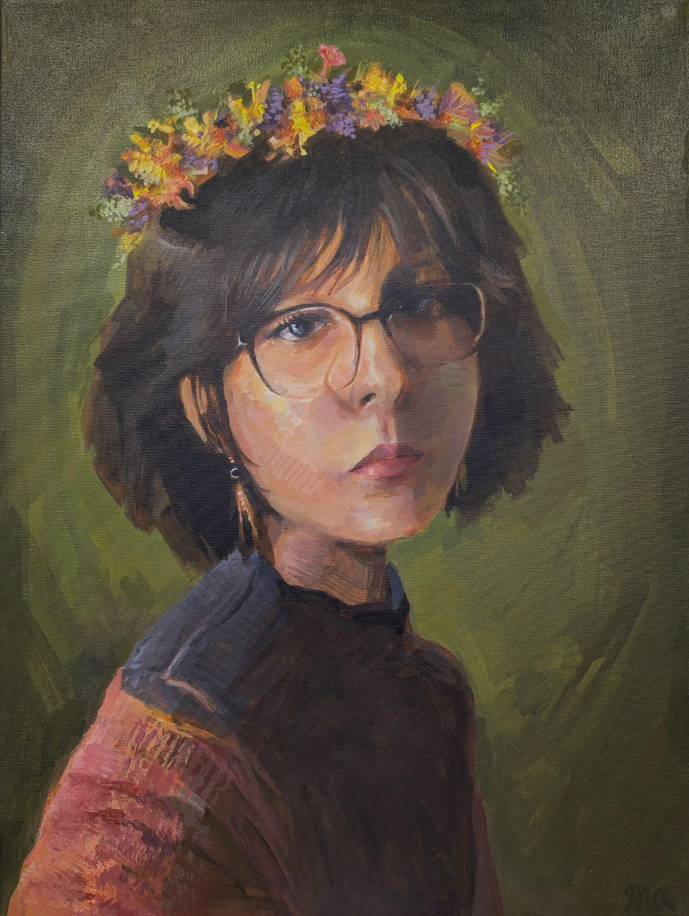
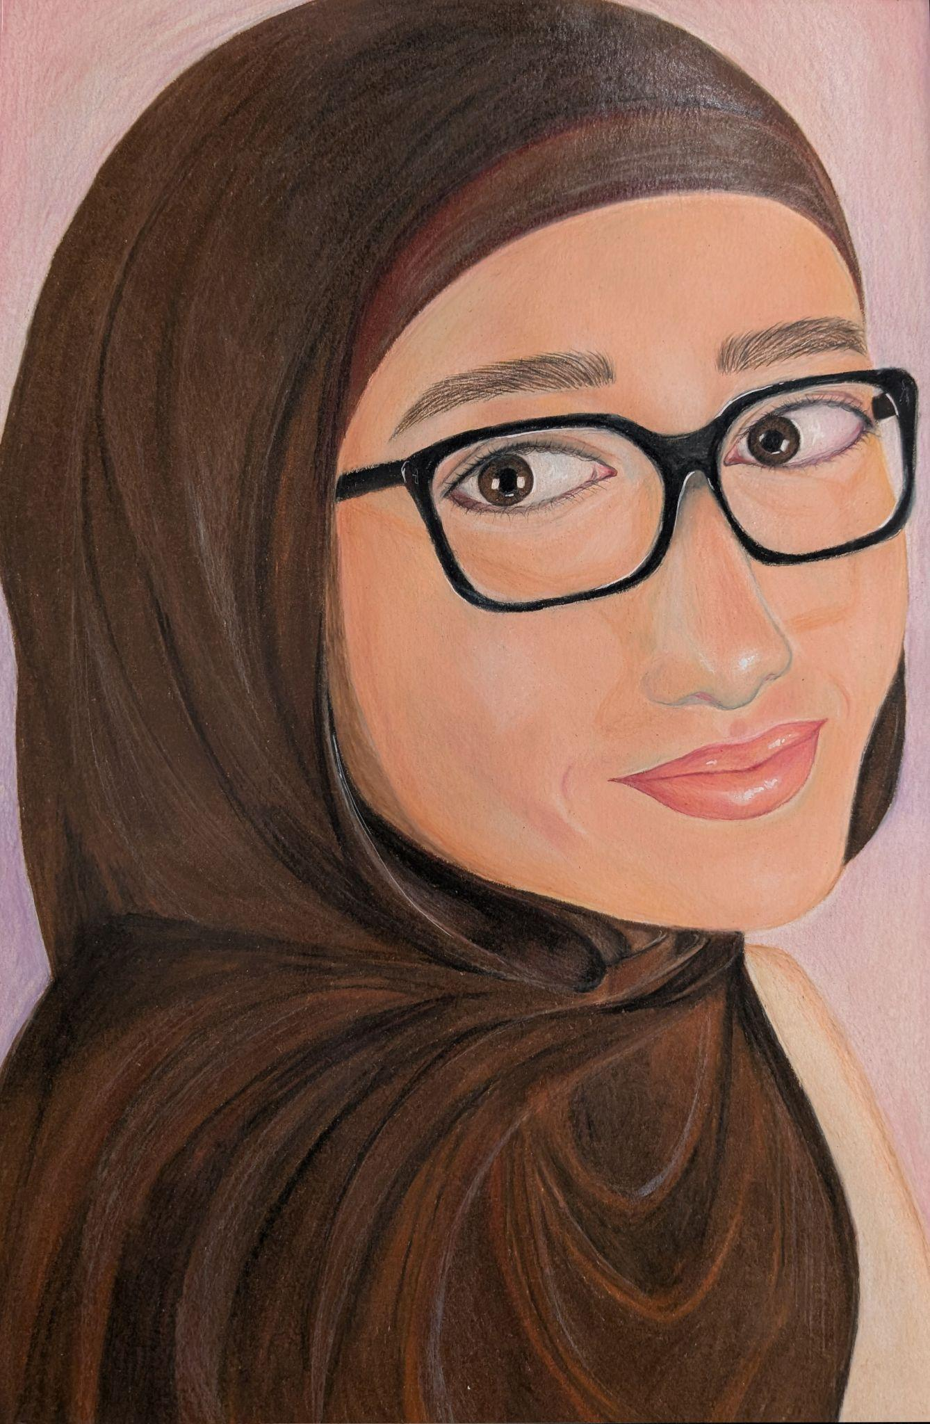
MBCC Senior Artist
Maria Alashwal
Amina Bazzi
Notes:
stand for acknowledgment

Slide 50
Dearborn Student Art Show
MBCC Participants
Nuha Milad
Mahdi Ayoub
Gwen Fazio
Amanie Alfatlawy
Mahdi Elsalman
Ameleya Abbas
Merna Abdallah
Mahmoud Awada
Skylar Johnson
Phi Vo
Notes:
stand for acknowledgment

Slide 51
CTE Honor Cord Recipients:
Huda Abbas Sara Ahmed Syed Akbari Maria Alashwal Shahd Alhabeeb Amani Alsayed Zakaria Altharhani Shada Alwaqedi Jouri Alzoubi Amina Bazzi Hussein Bazzi | Ann Boettger Jason Bundas Arianna Caperton Miryam Chamas Reem Charafeddine Carter Coykendall Abraham Dabajeh Maya Dakroub Rami Fawaz Cole Franklin

Slide 52
CTE Honor Cord Recipients:
Anwaar Gailan Valensia Gauna Sedra Ghazawai Yara Hamam Rewa Harb Sara Hijazi Yara Ibrahim Yazmine Jackson Ilyas Kady Farah Khachab Ramzi Lahbib Theodore Matta Nuha Milad | Devin Mitchell Eziah Nasir Jeremy Paddock Melani Paredones Medina Owen Righetti Yara Saleem Youssef Shehata Ayat Sohoubah Stavros Stylianou Jawad Tarraf Yasmeen Yaghmour

